Slide 1
2020 Census
Local Update of Census Addresses Operation (LUCA)
Promotion
Atlanta Regional Office
Managing Census Operations in:
AL, FL, GA, LA, MS, NC, SC
Notes:
Good morning/afternoon, my name is (insert NAME), from the Census Bureau’s (insert Division or Regional Office). Thank you for the opportunity to speak with you today to promote the 2020 Census Local Update of Census Addresses Operation (LUCA).

Slide 2
Agenda
2020 Census Overview
What is LUCA?
LUCA Confidentiality and Security
Statewide LUCA Participation in 2010
Other Census Geography Programs (GSS, BAS, PSAP)
LUCA Participation Media Options (GUPS, Digital, Paper)
Preparing For The 120 Day Review Period
Notes:
Briefly mention each bullet point.

Slide 3
Why allocate your limited resources to Census programs?
Political Power:
Census is constitutionally mandated for re-apportionment of Congress.
Census results are used for Redistricting at national, state, and local levels.
Informed Planning:
Federal, tribal, state and local use governments use Census data in their community planning and regional development.
Businesses and non-profits use Census statistics in their organizational decisions (e.g., where to locate, size of market, etc.)
Money/Economic Impact:
$400 Billion/year is distributed using Census numbers ($4 Trillion over the decade).
Notes:
Political Power:
The Census is used for the equitable distribution of power in our democracy, and results are used for Redistricting at national, state, and local levels.
Planning and Organizing:
To inform the decisions of governments, businesses and non-profits regarding community and regional development, education, agriculture, energy, and environmental programs, as well as other community improvements and enhancements. Census data informs communities so they may allocate resources for neighborhood improvements, public health, education, transportation, commercial activities, and much more.
Money:
Many federal and state funds are distributed using Census numbers to guide them.
Relatively small undercounts can have significant economic impact over the course of the decade until the next Census.

Slide 4
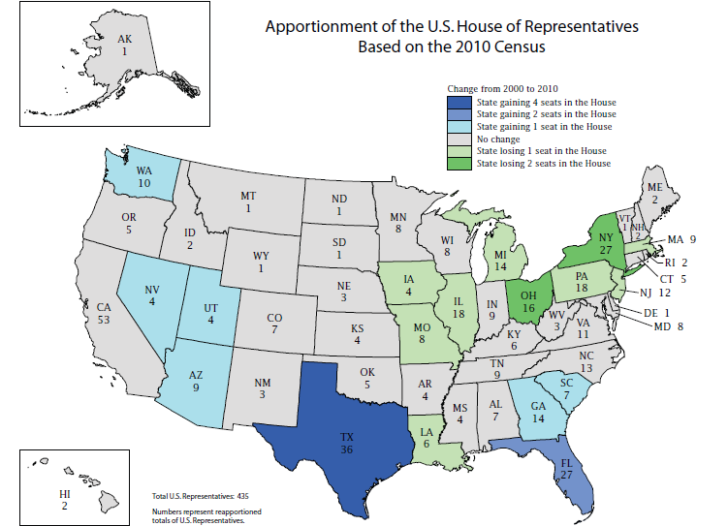

Slide 5
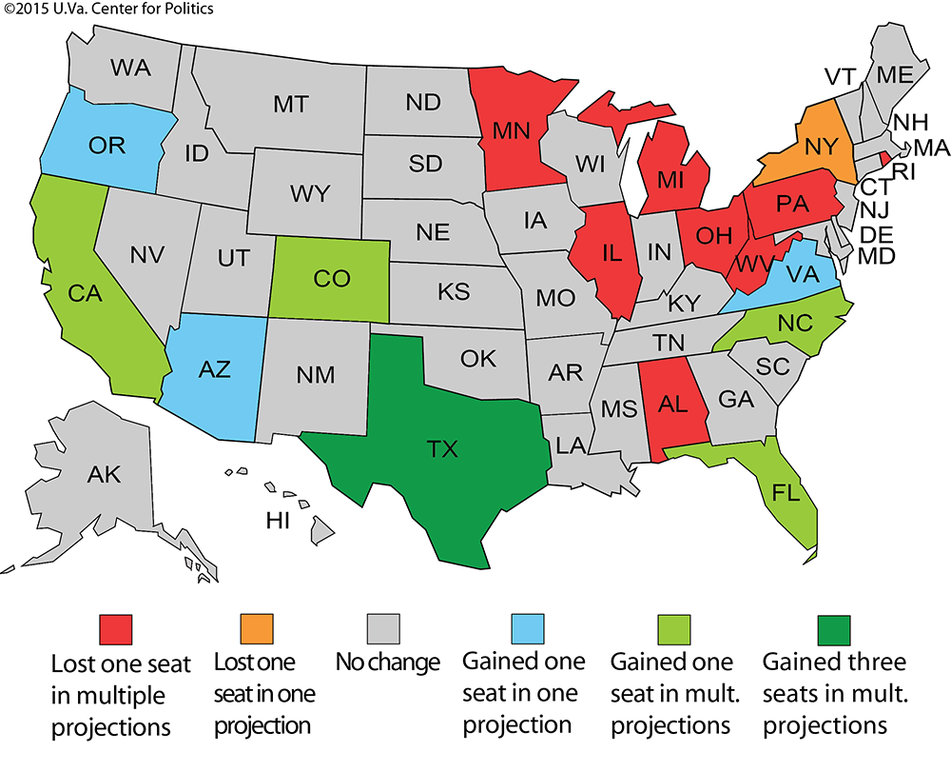
Notes:
These are not Census projections; this map is from the University of Virginia Center for Politics based on multiple projections by Election Data Services in their “2016 Reapportionment Analysis”.
These are mid-decade projections - very preliminary and subject to change. But, it is important to note that the foundation for these projections is based on the population counts from the 2010 Decennial. So, a question to ask is, how accurate do you feel the population counts were for your city or county in 2010? The next question to ask is, how many of the counties and cities represented here today participated in LUCA in 2010?
While multiple projections suggest Alabama may lose a seat – the margin is very, very close and an accurate population count is crucial…Which brings us to LUCA and why it is so important to start with a solid address list.

Slide 6
2020 Census Design
6
Notes:
This graphic illustrates the 2020 Census Design process and why building a strong geographic foundation is so important to the success of the 2020 Census.
We must Establish Where to Count – identify all the addresses where people could live.
We must Motivate People to Respond – use the address list to send mailed materials that invite and encourage households to respond.
We must Count the Population – use the address list and maps to send our enumerators to collect interview data from nonresponding households.
We must Release Census Results – use the address list and geographic boundaries to process, tabulate, and disseminate:
Apportionment counts to the President by December 31, 2020
Redistricting data to the States by April 1, 2021
High quality data to the public!
In this presentation and others you may receive throughout this year, the Census Bureau provides examples regarding the importance of LUCA participation and a successful 2020 Census that result after the “Release Census Results” section (Apportionment, Redistricting, Distributing billions in federal funding, Providing data for local analysis, etc.). While these are all valid reasons for participating in LUCA, this graphic illustrates why your LUCA participation is so fundamentally important. LUCA offers local governments the opportunity to provide their input into the address list that serves as the foundation of the entire 2020 Census Design process!
Participants in 2020 LUCA have a direct impact on the quality and completeness of the address list. Think of 2020 LUCA as a vehicle to “Get local government input” and “Establish Where to Count”.

Slide 7
Address List Maintenance 2010 - 2020
On-going Maintenance and Update
US Postal Service’s Delivery Sequence File (DSF)
Updates from tribal, state, and local government address lists and commercial address lists
Continuous identification of stability and change
Address Canvassing
Nationwide In-Office Address Canvassing
LUCA
Opportunity to review and update the Census Bureau’s address list for the 2020 Census
In-Field Address Canvassing
Annual In-Field data collection, checks, and tests
2010 Census
2020 Census
Notes:
To maintain the address list, the Census Bureau starts with a firm base from the 2010 Census. The address list was built on bi-annual processing of the US Postal Service’s Delivery Sequence File (DSF), last decade’s Local Update of Census Addresses (LUCA), the nationwide In-Field Address Canvassing that occurred in 2009 in preparation for the 2010 Census, as well as additional updates that occurred at the time of enumeration.
On-going address list maintenance and update activities not only rely on the DSF, but also on updates from tribal, state, and local government address lists and the Census Bureau’s internal work to identify areas of stability and/or areas of change.
The 2020 Census will include an Address Canvassing operation, but it will differ from previous decennial censuses. For 2020, a nationwide In-Office Address Canvassing operation will identify areas not requiring In-Field Address Canvassing. Areas of change or uncertainty identified during the In-Office operation will be included in an In-Field operation. The In-Field Address Canvassing operation leverages advancements in technology and operational improvements to make it more efficient than previous decennial canvassing operations. The Census Bureau also conducts data collection and quality checks through monthly surveys and Census Tests in advance of the decennial.
In looking at the far right portion of the slide, and as we have already discussed, LUCA provides an opportunity to review and update the Census Bureau’s address list. Therefore, LUCA serves as a component of address list maintenance leading into the 2020 Census.

Slide 8
What is the Local Update of Census Addresses Operation (LUCA)?
Authorized by the Census Address List Improvement Act of 1994 (Public Law 103-430).
2020 Decennial Census voluntary geographic partnership operation.
The one and only opportunity for tribal, state, and local governments to review and update the Census Bureau’s Address List for residential addresses and group quarters.
Notes:
The Census Address List Improvement Act of 1994, which became Public Law 103-430 in October 1994, authorized the Census Bureau to share its address list with governments who sign a confidentiality agreement.
LUCA is a voluntary geographic partnership operation.
LUCA provides the one and only opportunity for tribal, state, and local governments to review and comment on the Census Bureau's residential address list for their jurisdiction prior to the decennial census. The Census Bureau relies on a complete and accurate address list to reach every living quarters and associated population for inclusion in the census.

Slide 9
Why LUCA Is A Critical Component For An Accurate 2020 Census
Before we count people, we need an accurate list of the living quarters where we need to count them.
LUCA improves the Census Bureau’s Address List.
Local Governments are almost always the best source of address data (GIS, E911, Property Tax Assessors, and/or Utility Services, etc...).
The accuracy and completeness of the address list is critical to the success of the Census.
An accurate Address List leads to an accurate Population Count.
Notes:
The accuracy and completeness of the address list is critical to the 2020 Census. Your participation in LUCA can help ensure an accurate 2020 Census for your community.
Local Governments are the best source of address data, and we need local government input via LUCA.

Slide 10
What’s New for LUCA 2020
Includes ungeocoded address records for state and county participants.
Includes residential structure coordinates, if available.
Allows participants to submit residential structure coordinates, if available.
Allows participants to submit non-city style addresses with corresponding map spots.
Requires residential multi-unit structure identifiers (Apt 1, Unit A2, Lot 17, #3001, etc.)
Notes:
The ungeocoded addresses are USPS DSF addresses that we could not geocode. Ungeocoded addresses cannot be included in Census unless we determine the geocode/location.
If available, LUCA provides Census Bureau structure coordinates and allows participants to submit structure coordinates accompanying address points.
Allows participants to submit residential structure coordinates, if available.
Allows participants to submit non-city style addresses with corresponding map spots.
Requires residential multi-unit structure identifiers (Apt 1, Unit A2, Lot 17, #3001, etc.)

Slide 11
Confidentiality and Security
The information provided to/from LUCA is covered under Title 13 of the United States Code which:
Requires the Census Bureau maintain the confidentiality of all information it collects.
Requires the Census Bureau to ensure confidential treatment of census-related information, including individual addresses and map structure points.
Requires that all LUCA liaisons, LUCA reviewers, and anyone with access to Title 13 materials abide by the Confidentiality and Security Guidelines.
Requires certification of return or destruction of Title 13 data after LUCA ends.
Notes:
The information provided to/from LUCA is covered under Title 13 of the United States Code, which:
Requires the Census Bureau to ensure confidential treatment of census-related information, including individual addresses and map structure points. Structure points identify the location of living quarters.
Requires that all liaisons, reviewers, and anyone with access to Title 13 materials abide by the Confidentiality and Security Guidelines, which will be mailed to your Highest Elected Official with the LUCA invitation package in July 2017.
And, requires that the Census Bureau maintain the confidentiality of all of the information that it collects.
All Title 13 LUCA materials must be returned or destroyed after LUCA ends.

Slide 12
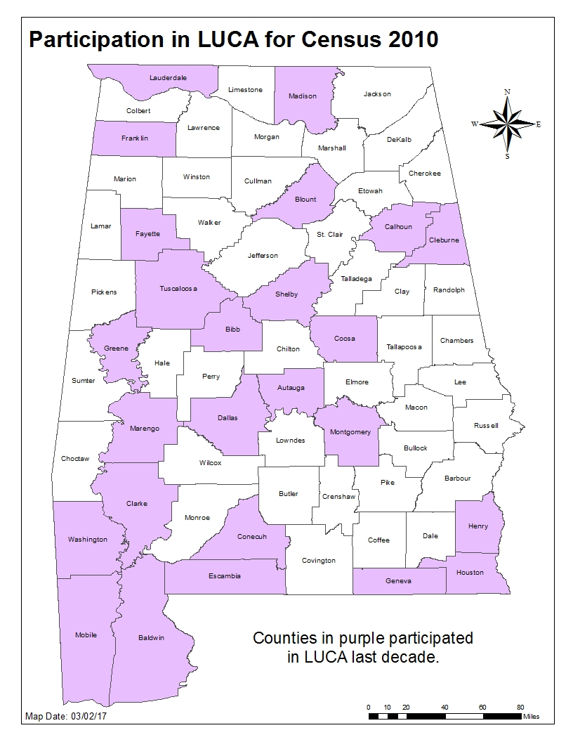
Counties in AL = 67 # in LUCA2010 = 25 37% of AL counties participated in LUCA for 2010.
Notes:
This is a broad definition of “participation” depicted in these next few slides. Some of these participants dropped out of LUCA, some of them simply said they agreed with our address list.
Many other entities did a very detailed review of their address list, and we encourage you to make plans now so you can go beyond mere participation, and conduct a thorough review during 2020 LUCA.

Slide 13
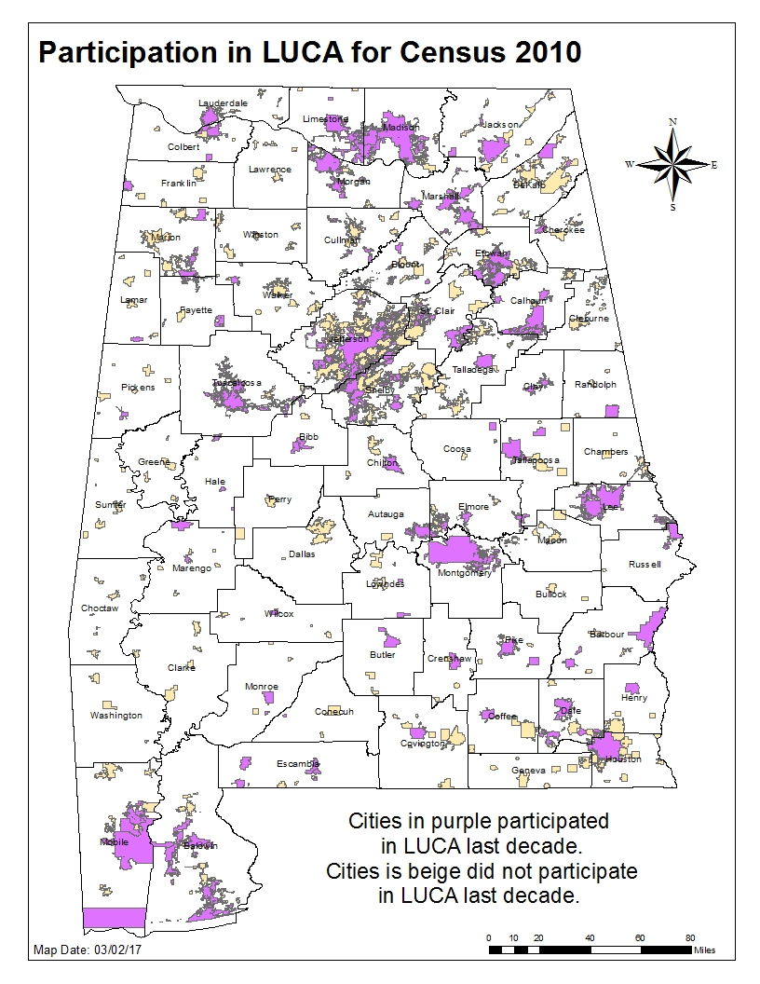
Cities in AL = 461 (does not include CDPs) # in LUCA2010 = 137 30% of AL cities participated in LUCA for 2010.
Notes:
And here we have a map of the incorporated cities in Alabama that participated in LUCA in 2010.

Slide 14
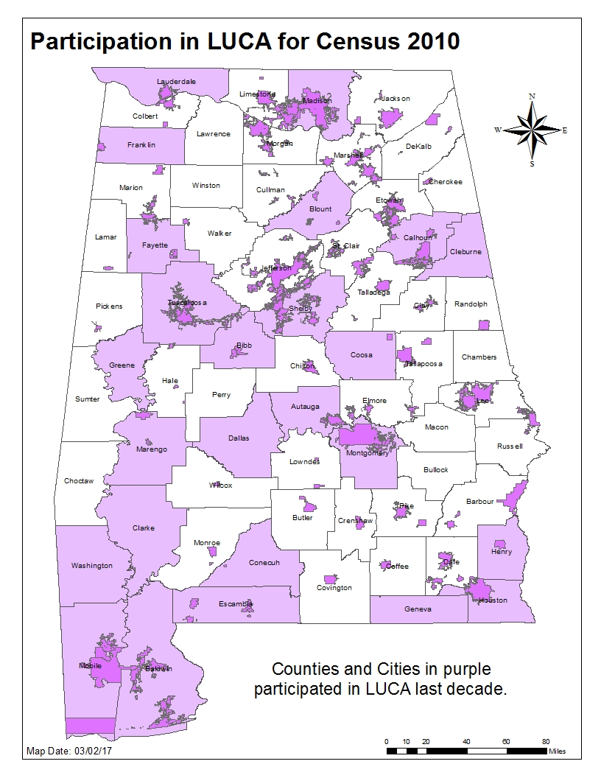
For all areas in white, there was no local review of the Census address list for the 2010 Census.
Notes:
For all the areas in white, there was no local participation in 2010 LUCA, and no local review of the address list.
If no one reviews the address list for 2020 in these same areas, we could repeat the same errors.

Slide 15
Geographic Support System (GSS) Program
Integrated program of improved address coverage, continual spatial and feature updates, and enhanced quality assessment and measurement.
Supports and maintains the geographic and cartographic infrastructure necessary for the Census Bureau’s data collection, processing, tabulation, and dissemination programs for the United States and Puerto Rico.
Provides for continual updates throughout the decade to support current surveys and the 2020 Census.
Notes:
<Presenter: DO NOT READ ALOUD, but if receive specific questions related to the GSS status of a county, take the information and inquire with GEO-ADCPB.>
MAF accuracy is not totally dependent on LUCA. The Census Bureau is continually updating and improving the MAF with several ongoing operations, including the Geographic Support System (GSS) Program.
As mentioned on a previous slide, updates from tribal, state, and local governments are part of the Census Bureau’s ongoing maintenance and update of their address list. The Census Bureau has undertaken the Geographic Support System (GSS) program in an effort to maintain the address list as well as continually research and update the address frame.
The GSS is an integrated program of improved address coverage, continual spatial and feature updates, and enhanced quality assessment and measurement. It supports and maintains the geographic and cartographic infrastructure necessary for the Census Bureau’s data collection, processing, tabulation, and dissemination programs for the United States and Puerto Rico and provides for continual updates throughout the decade to support current surveys and the 2020 Census. The program goal is to acquire address and spatial files for every census tract in the US and Puerto Rico. Since fiscal year 2011, the Census Bureau conducted research and development, acquired available files and updated their MAF/TIGER database using those acquired sources. In fiscal year 2017, the Census Bureau expects to complete a “Pass of the Nation” for the GSS program. Yearly budgetary constraints did not allow contact with all potential partners regarding the GSS program. The Census Bureau attempted to acquire data from state, county and regional agency partners, helping to streamline the GSS file acquisition process.
For fiscal year 2018 and beyond, the Census Bureau will selectively acquire and process files based on areas of change/growth, governmental entities unable to participate in LUCA and areas identified during the In-Office Address Canvassing operation. The vision after the 2020 Census concludes is to continue leveraging partners via the GSS program in order to provide continual updates in support of census surveys and future decennials.

Slide 16
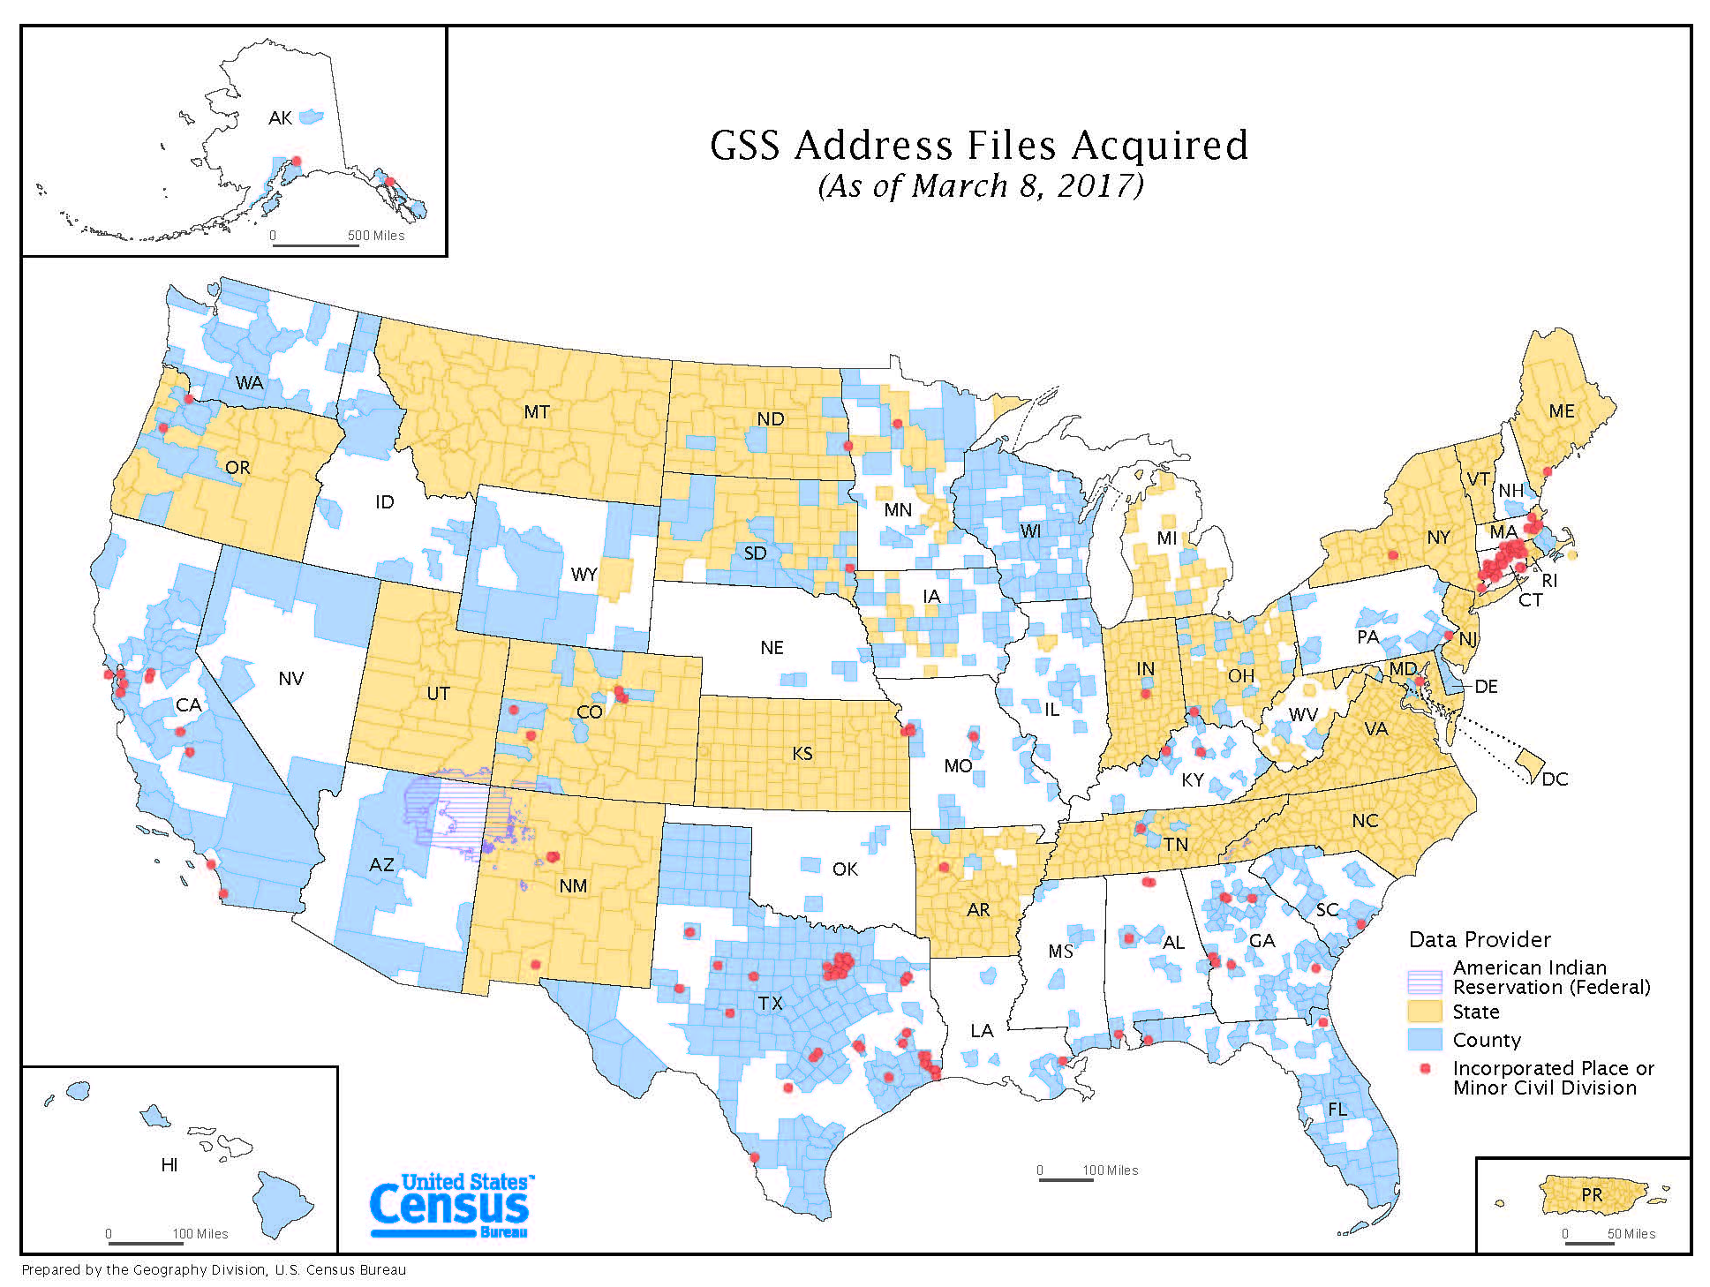
Notes:
The best address data comes from local governments, and we do not want to duplicate local government efforts.
For areas where we have received GSS data, this means that our address list going into 2020 will be better than it was going into 2010, but GSS is an automated update process that is not 100% effective with the thousands of local address lists that come in hundreds of different database formats. Some amount of addresses should be expected to “fall through the cracks” in the automated GSS processing, and some areas were processed years ago, so newer changes would not be captured.
Only through the LUCA program can local governments examine the details, and correct the actual address list that Census will use for 2020.

Slide 17
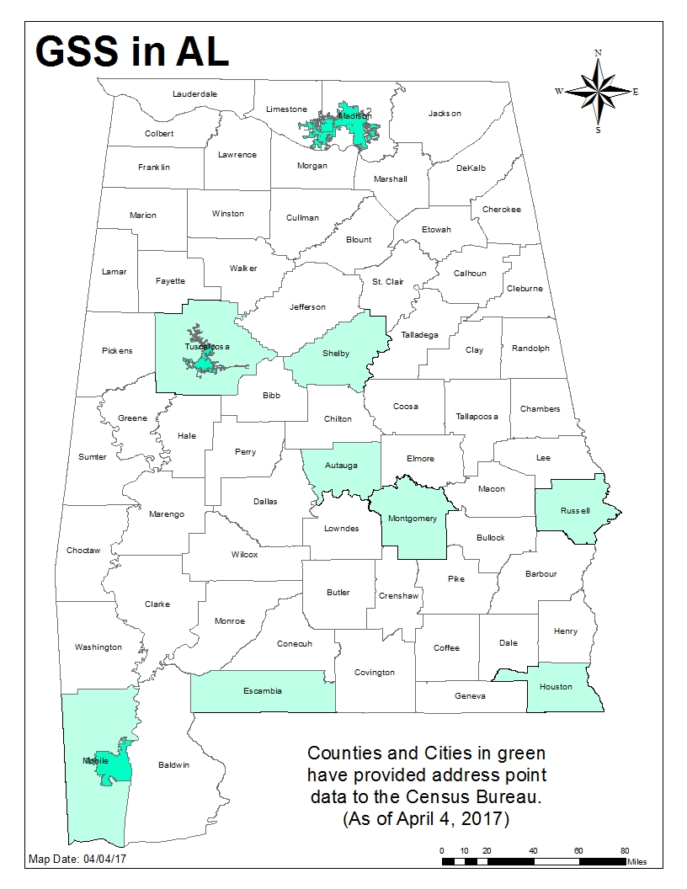
AL counties and cities with address point data acquired by Census:
Counties
Autauga
Escambia
Houston
Mobile
Montgomery
Russell
Shelby
Tuscaloosa
Cities
Huntsville
Madison
Mobile
Tuscaloosa
Notes:
This is what the GSS program participation looks like in Alabama. The counties and cities in green have provided address point data to the Census Bureau.
- comment on whether we have received data for the area we are visiting, and where did the data come from (the county?, the state?)

Slide 18
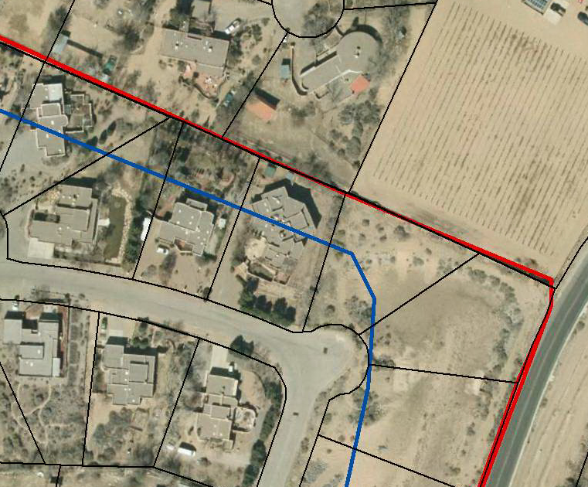
Boundary and Annexation Survey (BAS)
If Census place boundary (blue) is not corrected to aligned with the accurate locally-sourced place boundary (red) and parcels (black), housing units may be misallocated.
Annual BAS Schedule:
December/January – program information sent to participants
January 1 – Date that Annexations must be legally in effect
March 1 – submission deadline for Population Estimates program and ACS
Notes:
Address lists are critical, but so are boundaries!
After the 2000 and 2010 censuses, the Census Bureau researched numerous complaints of undercounts from local governments in the Count Question Resolution program (CQR). After thoroughly researching each of these situations, we often found the undercount was not due to Census missing the population, but rather, the population was misallocated because the boundary was inaccurate.
Notice the boundaries in these examples. The blue line is where Census has recorded the boundary; red is the accurate boundary from the local government. In between are the parcels that will be misallocated. So, even if your jurisdiction has not had any legal changes in its boundaries, it is important to verify that the boundaries are portrayed accurately for your jurisdiction.
The Boundary and Annexation Survey is done annually, and for BAS 2017, we are collecting the boundaries in effect as of Jan. 1, 2017. An annexation that becomes effective on February 3, 2017 would need to be reported in the 2018 BAS.
The legal boundaries as collected in BAS also determine the universe of addresses that will be shared with a local government in the LUCA program.
To ensure boundary updates are included on the LUCA materials, all boundary updates must be returned to the Census Bureau by May 31, 2017.

Slide 19
2020 Participant Statistical Areas Program (PSAP)
An opportunity for designated representatives to review and update statistical geographies for 2020 Census data tabulation.
Coordinating agencies can review, identify, propose changes, and delineate new census tracts, block groups, census designated places (CDPs), and census county divisions (CCDs).
2 Phases:
Delineation (120-day review)
Verification (90-day review)
Participation Options:
Standard Statistical Geographies: GUPS (Geographic Update Partnership Software)
Tribal Statistical Geographies: GUPS or Paper Maps
Tentative Schedule:
Program Invitation – Fall/Winter 2017
Materials Available – Winter 2018
PSAP Verification – Fall/Winter 2019
Notes:
PSAP is an opportunity for designated representatives to review and update statistical geographies for 2020 Census data tabulation.
Participants can review, identify, propose changes, and delineate new census tracts, block groups, census designated places (CDPs), and census county divisions (CCDs).
Delineation (120-day review)
Verification (90-day review)
Standard Statistical Geographies will use Geographic Update Partnership Software – GUPS to process changes and delineations.
Tribal Statistical Geographies will have the option of using GUPS or paper maps.
This is a TENTATIVE (emphasize) schedule for the upcoming PSAP program.

Slide 20
2020 Participant Statistical Areas Program (PSAP) “Plan” New for 2020
GOAL: Clean, Consistent Statistical Geography Nationwide
Census Bureau intends to create a 2020 statistical areas “plan” for both the standard and tribal statistical geographies, which our partners can review and update.
Lessens burden on our partners.
Ensures that ALL statistical geographies are reviewed/updated consistently.
More extensive review than just criteria thresholds.
Partners can update the 2020 “plan” OR update from 2010 statistical geography base.
Notes:
GOAL: Clean, Consistent Statistical Geography Nationwide
Census Bureau intends to create a 2020 statistical areas “plan” for both the standard and tribal statistical geographies, which our partners can review and update.
Lessens burden on our partners.
Ensures that ALL statistical geographies are reviewed/updated consistently.
More extensive review than just criteria thresholds.
Partners will have the option to update the 2020 “plan” OR update from 2010 statistical geography base.

Slide 21
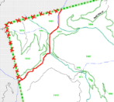
2020 Participant Statistical Areas Program (PSAP) Participation Options & Schedule
Standard Statistical Geographies:
GUPS
Geographic Update Partnership Software
Tribal Statistical Geographies:
GUPS
or
Paper Maps
Tentative Schedule:
Program Invitation – July 2017
Materials Available – December 2018
PSAP Verification – December 2019
Notes:
This is a TENTATIVE (emphasize) schedule for the upcoming PSAP program.

Slide 22
LUCA Timeline
January 2017: Advance notification for LUCA mailed.
April 2017: LUCA promotional trainings begin.
July 2017: Invitation letter and registration forms mailed. We recommend registering before the end of August.
October 2017: Technical training workshops begin.
February 2018: Participation materials mailed to registered participants (120 day clock begins upon receipt). This is the time technical staff needs to be available. We recommend that you plan now to ensure adequate budget and resource availability during this time period.
August 2019: Feedback materials sent to participants and the 30 day appeals process begins.
April 1, 2020: Census Day.
Notes:
Returning our focus back to the LUCA program, let’s review the timeline.
Take special note of the items in red.
Jan 2017 – your office should have received an Advance Notification letter. Please respond to this with contact information updates.
April 2017 – LUCA promotional trainings begin (this is what you are attending right now).
July 2017 – Invitation letter and Registration forms mailed to HEOs. We recommend registering before the end of August 2017 – State partners and Census staff will be following up with entities that have not registered beginning in August or September 2017.
October 2017 – Technical training workshops begin (locations TBD, also will be available online as webinar).
February 2018 – Participation materials mailed to registered participants (120 day clock starts ticking upon receipt). FOR YOUR PLANNING PURPOSES, this is the time that you need technical staff (or interns, contractors, etc.) available to do the careful and detailed review of the Census address list. This is NOT easy work. It can be very tedious and time consuming.
August 2019 – Feedback materials sent to participants. Participants will have an opportunity to appeal these results - participants will have 30 days from receipt of feedback materials to file an appeal with the Appeals Office.
April 1, 2020 – Census Day!

Slide 23
Preparing For LUCA 120 Day Review Period
Participate in the 2017 Boundary and Annexation Survey (BAS) to ensure your jurisdiction’s boundaries are accurate and up to date prior to LUCA.
Develop your address review strategy and determine team of reviewers – Estimates are between 16 to 672 hours to complete the address review and submit updates.
Coordinate your partnership with overlapping and neighboring county, city, and state governments.
Determine, assemble, and prepare your local address sources.
Determine the format for your LUCA materials.
Geocode your local address list using the on-line Census Geocoder.
Access the Census Address Block Count List for your jurisdiction online and compare these counts to your local sources.
Notes:
120 days is not a long period of time to review every residential address in an entire city or county!!
There is much that can be done in advance of the 120 day review period so that you can “hit the ground running.”
Briefly mention each bullet on the list.
Teams of reviewers – Some larger cities had two or three dozen reviewers as a part of their team.
Note: An entity can designate another organization to participate on their behalf, such as a county conducting the review for a place, state/regional planning agency reviewing for a county, etc.

Slide 24
Assembling Your LUCA Team
HEO
Highest Elected Official – Governors, County Chairs, Tribal Chairs, Mayors.
July 2017 - Receives the invitation and registration materials.
Selects the LUCA Liaison.
Completes and returns the registration form.
If participates in the review or acts as the LUCA Liaison, must sign confidentiality agreement

Slide 25
Assembling Your LUCA Team Continued
LUCA Liaison
Will receive the LUCA materials when mailed out in the spring of 2018.
Responsible for organizing the LUCA address review.
Must sign and agree to the confidentiality and security agreement.
Responsible for ensuring that all of the confidentiality and security measures are met.
Selects a team of Reviewers to assist in the address review.
Participate in a LUCA Technical Workshop in the Fall of 2017!!

Slide 26
Assembling Your LUCA Team Continued
Reviewers
Team selected by the HEO and/or LUCA Liaison to assist in the address review.
Must sign and agree to the confidentiality and security agreement.
Participate in a LUCA Technical Workshop in the Fall of 2017!!
Notes:
Consider coordinating with your county or your state. As long as they sign a confidentiality agreement for YOUR governmental entity, they can assist in your address review, or even act as your Liaison (if they agree).
Consider interns when choosing your Reviewers. This is a great opportunity for students to get practical work experience for their resumes, and for local governments to get budget-friendly assistance in completing your address review.

Slide 27
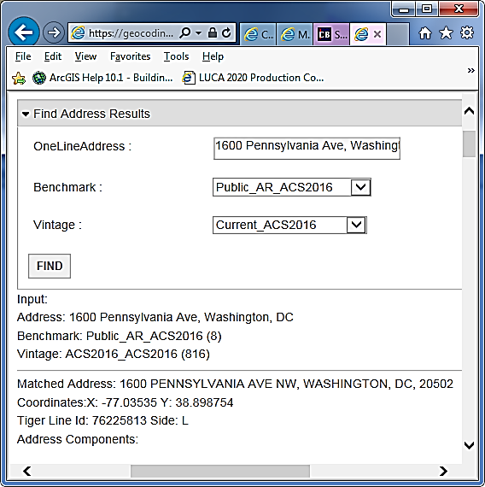
Early Tools For LUCA Partners
Updated Census Geocoder Tool
Takes individual addresses or a file of addresses and obtains
approximate coordinates and census Geography.
Increase the maximum number of records from 1,000 to 10,000.
Provides an alternate
path for larger
governments to
submit addresses
to be geocoded when
you have an address list
that is not geocoded
(not linked to points
or parcels or any
particular location.)
24 hour turnaround on the results.
Notes:
If you have an address list that is not linked to address points or otherwise geo-located, this tool will geocode your address list for you.
The Census Geocoder is accessible through the LUCA webpage: www.census.gov/geo/partnerships/luca.html
It is an address lookup tool that converts addresses to an approximate coordinate and returns information about the address range in relation to other geographies.
Initially the Census Geocoder could only process batches of 1,000 records, but now the record limit is 10,000. At this time, users with more than 10,000 address records must divide their file into multiple files for processing. The Census Bureau will provide another means for governments to submit a larger number of addresses for geocoding without splitting into 10,000 record increments. Details are forthcoming on that process.
When geocoding your address, you need to select a benchmark (time period) and select a vintage of geography. The benchmark is the time period when we created a snapshot of our data (generally done twice a year). For example, Public_AR_Census2010 is the snapshot we took of the database in 2010. Public_AR_Current is the most recent snapshot we took of our dataset. The vintage of geography is the census or survey that the data relates to. For example, Census2010_Census2010 are the address ranges from the 2010 Census at the time of the 2010 Census. You can also obtain the 2010 Census address ranges as of our most recent benchmark. The vintages you see available depends on the benchmark you selected.

Slide 28
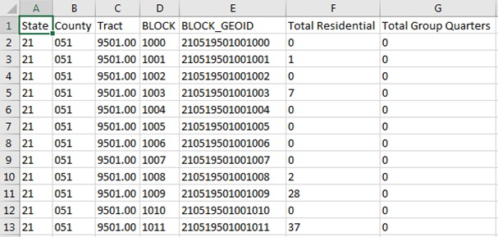
More Early Tools For LUCA Partners
Early Address Block Count List
Providing an early address block count list for partners in January 2017 (includes count of residential addresses and group quarters by block).
Address Block Count lists can be linked/joined to 2016 TIGER/Line shape files.
Notes:
The Census Bureau is excited to offer participants the opportunity to begin LUCA preparation in advance of LUCA registration. For the first time, residential address block counts are available for download on the LUCA website. These residential block counts are current as of January 2017 and provide counts of housing units and group quarters for every block in your jurisdiction. The Census Bureau intends to update the counts again in July 2017.
Use the “How Can I Review the Address Block Counts for My Entity” section to search and download the Address Block Count file for your government. The download is in pipe-delimited text format, but easily converts into Excel (.xlsx). The Geographic Programs Support Desk can assist with the process if necessary. I will provide their information at the end of the presentation.
This slide shows an example of the layout for the block count list which includes the geographic codes and count of residential addresses (housing units and group quarters) by census block. To prepare for LUCA, potential participants can compare the Census block count data to their local data. They can join the block count data to census block geography using a Geographic Information System (GIS) and use the results to identify areas to focus their LUCA review.
<Presenter: As time permits (or after the presentation), navigate to the LUCA website and show this section/action.>
To view your Address Block Counts on a map, download the block layer 2016 TIGER/Line shapefiles for your state and follow the instructions for Joining Census Data to TIGER/Line Shapefiles [PDF].

Slide 29
Preparation – Address List Formats
Paper
Available to governments with 6,000 or fewer addresses.
Legal size (8.5” x 14”) – 6 addresses per page.
Two sorts:
Street Name/House Number.
Census Tract number/Block number/Street Name/House Number.
Separate ‘Add Page’
Digital
Available to all governments.
Excel (.xlsx) or Comma Delimited Text (.csv) format.
No separate ‘Add Page’.
Notes:
The next few slides discuss the materials that comprise the Paper and Digital participation methods, so you can begin to think about which is best for your government.
The paper format address list is only available to participants with 6,000 or fewer addresses. While this may seem like a low number, more than half of the eligible governments have less than 6,000 addresses!
The address list is printed legal size (8.5 x14 inches) with only six addresses per page. There are two “sort options”: Street Name/House Number OR Census Tract number/Block number/Street Name/House Number. Each has pros and cons as it relates to a review. Consider your ability to re-sort your local list to match one of these sort options as well as whether or not geographically defining areas for your review is possible. Census Bureau staff can discuss sort options and help you choose. Additionally, a separate paper “Address List Add Page” is necessary for participants to add new or missing address records. Examples of the paper Address List and Address List Add Page are forthcoming.
The digital format address list is available to all governments. Different from 2010 LUCA, the Census Bureau is providing the 2020 LUCA digital address list in Excel (.xlsx) or Comma Delimited Text (.csv) format. A database or spreadsheet software such as Microsoft Access or Microsoft Excel is necessary to use the digital format address list. There is no need for a separate ‘Add Page” to add records. Selection of this format allows GIS users to create coordinates from the latitude/longitude values included in the address list.
You can also use commercial GIS software, such as ESRI ArcGIS. With this option, you will need a database software program such as Excel to view the address list and can view maps via the Census Bureau partnership shapefiles.

Slide 30
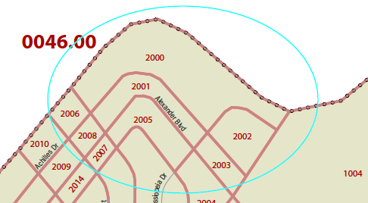
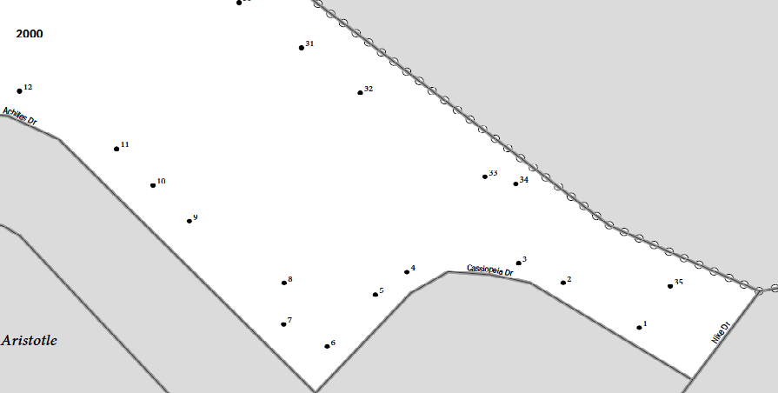
Map Media types
Electronic Map Media
Maps are provided as TIGER partnership shapefiles
Paper Map Media
Large format paper map(s) (36” X 42”) along with a DVD of small format (8.5” X 14”) block maps in Adobe PDF format
Notes:
We have two map media type options.
We will provide LUCA TIGER Line shapefiles to those participants that register to receive Electronic maps. This option is not to be confused with the DVD of small format PDF census block maps that accompany the Paper Map media selection.
The Paper map media choice does not have an address record limitation, though there are clearly limits to their usability for larger governments that could have hundreds of large format maps and thousands of small format pdfs.

Slide 31
Geographic Update Partnership Software (GUPS)
Customized Geographic Information System (GIS) software for participation in the 2020 LUCA operation.
Designed to be usable for participants with no GIS experience, but may also be the best choice for GIS users.
Allows for both simple and complicated reviews and edits.
Allows participants to add external geospatial data (shapefiles, geodatabases, and imagery) for comparison and update purposes.
Quality Check/Validation Tool within GUPS assures LUCA edits are valid before submission file(s) are created.
No internet connection required.
Notes:
We saved the best for last: GUPS!!
The Geographic Update Partnership Software, or GUPS, is a tool provided by the Census for performing the 2020 LUCA operation. GUPS was designed with the participant in mind. Pre-packaged to include all of the components for 2020 LUCA, GUPS contains the Census Bureau’s address list, block count list, and TIGER partnership shapefiles. GUPS allows the participant to add external geospatial data (shapefiles, geodatabases, and imagery) for comparison and update purposes. It is user friendly, and has been designed to allow for simple to complicated LUCA reviews and edits. It has also been programmed with a review tool that requires the user to validate their edits before creating a submission file. This assures the file(s) participants submit will not be rejected, and allows for easier processing once received by the Census. Finally, all data (install, address list and shapefiles) will be delivered on DVD. Using GUPS for 2020 LUCA does not require an internet connection, however, if you wish to use the imagery server, you will need a connection.

Slide 32
Geographic Update Partnership Software (GUPS)
Customized Geographic Information System (GIS) software for participation in the 2020 LUCA operation.
Designed to be usable for participants with no GIS experience, but may also be the best choice for GIS users.
Allows for both simple and complicated reviews and edits.
Quality Check/Validation Tool within GUPS assures LUCA edits are valid before submission file(s) are created.
No internet connection required.
Notes:
We saved the best for last: GUPS!!
After initial data load, the GUPS screen will look very similar to this.
The Geographic Update Partnership Software, or GUPS, is a tool provided by the Census for performing the 2020 LUCA operation. It is a customized GIS software designed specifically for the LUCA operation. GUPS was designed with the participant in mind. It is user friendly, and has been designed to allow for simple to complicated LUCA reviews and edits. It has also been programmed with a review tool that requires the user to validate their edits before creating a submission file. This assures the file(s) they submit will not be rejected and allows for easier processing once received by the Census. Finally, all data (install, address list and shapefiles) will be delivered on DVD. Using GUPS for 2020 LUCA does not require an internet connection, however, if you wish to use the imagery server, you will need a connection.

Slide 33
Prioritizing Your Review
When a complete review is not possible, focus your review on these areas:
Group quarters – College dorms, nursing homes, correctional facilities, etc.
Areas of new construction.
E-911 conversion areas.
Single/multifamily home conversions.
Warehouses converted to residential.
New mobile homes.
Apartment buildings with irregular/missing numbering schemes.
Annexed land.
Areas along governmental boundaries.
Blocks with the greatest count differences between the Census Bureau’s address block count and your address block count.
State and county reviewers should also focus on the ungeocoded list.
Notes:
When a complete review is not possible – Prioritize and focus your resources.
Presenter should read and discuss each item on this list.
Explain that the ungeocoded list has addresses that USPS has shared with us as deliverable, residential addresses but Census was unable to geocode them. If the address does not get geocoded, it will not be included in Census.

Slide 34
http://www.census.gov/geo/partnerships/luca.html (check this website for updates)
Notes:
LUCA Information updates area available on the 2020 LUCA website.

Slide 35
Upcoming LUCA Workshops
City | Date | Time
Muscle Shoals/Florence | June 12, 2017 | 10:00 AM
Huntsville | June 13, 2017 | 10:00 AM
Birmingham | June 14, 2017 | 1:30 PM
Gadsden | June 14, 2017 | 9:00 AM
Tuscaloosa | June 15, 2017 | 10:00 AM
Mobile | June 19, 2017 | 10:00 AM
Thomasville | June 20, 2017 | 10:00 AM
Montgomery | June 21, 2017 | 10:00 AM
Dothan | June 22, 2017 | 10:00 AM

Slide 36
2020 Census LUCA
Questions?
Toll free LUCA Helpline:
(844) 344-0169
Email: GEO.2020.LUCA@census.gov
Website: https://www.census.gov/geo/partnerships/luca.html
Atlanta Regional Office Geography Department:
(404) 331-1339
atlanta.geography@census.gov
Notes:
Again, I want to thank you for the opportunity to speak with you today about LUCA. How to find help, and other contact information is on the screen for your reference. At this time, I would be happy to take any questions you have.
I (speaker) have business cards I can give to you; feel free to contact me with any questions you have.

